Slide 1

CRYPTOCURRENCY
Analyzing trends in the cryptocurrency market using Power BI
-by SAVITHA

Slide 2

Introduction
Overview of Cryptocurrency Importance:
Explain that cryptocurrencies represent a new era in digital finance, with the potential to disrupt traditional banking systems.
Mention the rapid growth and increasing adoption of cryptocurrencies worldwide, which makes understanding their behavior critical for investors, analysts, and enthusiasts.

Slide 3

Why Cryptocurrency?
Why this Project?:
Describe how the volatility and market trends of cryptocurrencies can offer both high risk and high reward.
Note that this dashboard is designed to help users visualize trends, understand market patterns, and make better decisions in this unpredictable field.

Slide 4
PAST Relevance
Past Relevance:
Historical Data Analysis: Emphasize how historical data allows users to recognize long-term patterns, observe market cycles (e.g., bull and bear markets), and study the impact of past events on cryptocurrency prices.
Key Insights from Past Data: For instance, users can identify specific periods where significant price movements occurred and understand factors influencing those changes.

Slide 5
PRESENT Relevance
Present Relevance:
Real-Time Decision Making: Highlight how current data empowers users to make immediate, informed choices based on recent trends in price, volume, and market cap.
Market Conditions: Explain how users can gauge the current market sentiment—whether bullish, bearish, or stable—and decide accordingly.

Slide 6


Future Relevance
Future Relevance:
Predictive Insights: By using historical and current data trends, users can anticipate future price movements or market changes.
Investment Strategy: Provide examples of how predictive trends can guide future investments, helping users to plan entry and exit points more strategically.

Slide 7
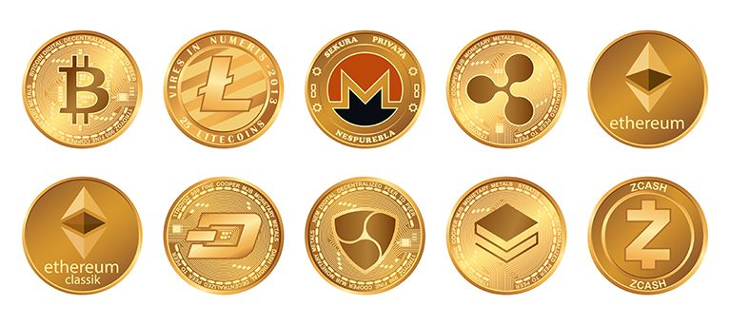

Slide 9

About the Dataset
Columns and Their Importance:
Name: Identifies each cryptocurrency, which is crucial for asset-specific analysis.
Date: Tracks daily performance, enabling trend analysis over time.
Open, Close, High, Low: Shows daily price range, critical for understanding volatility and calculating price changes.
Volume: Reflects the trading activity level, indicating how many units were bought/sold, which can be an indicator of market interest and liquidity.
Market Cap: Represents the total market value of each cryptocurrency, often seen as a measure of the asset's overall market size and stability.
Data Source and Processing:
Specify where the data was obtained (e.g., financial data providers, cryptocurrency exchanges).
Mention any preprocessing done, like handling missing values or converting date formats.

Slide 10

Insights and Recommendations
Visualizations and Key Insights:
Price Trend Visualization:
Explain how line charts or area charts of the open, close, high, and low prices over time can help users understand the fluctuations and potential points of growth or decline.
Insight: Spot patterns like consistent rises or sharp drops, which may correspond to market or economic events.
Volume and Market Cap Analysis:
Use bar charts or line graphs to show the trading volume and market cap, identifying periods of intense trading or significant market growth.
Insight: High volume can indicate increased investor interest, while a growing market cap may suggest strengthening confidence in the asset.
Top Performing Cryptocurrencies:
Visuals like bar charts or tables to compare different cryptocurrencies, helping users quickly identify the highest-performing assets.
Insight: Focus on high-stability or fast-growing cryptocurrencies for potential investments.

Slide 11

Conclusion
Summary of Findings:
Recap key insights: summarize the main patterns observed, such as periods of high growth, consistent performers, and high volatility points.
Highlight trends and anomalies to show how they can influence strategic decisions.
Importance of Data Visualization:
Emphasize how visual tools help transform complex cryptocurrency data into actionable insights.
Mention that this dashboard allows users to interact with data, filter specific assets, and analyze both historical and real-time metrics for better decision-making.

Slide 12
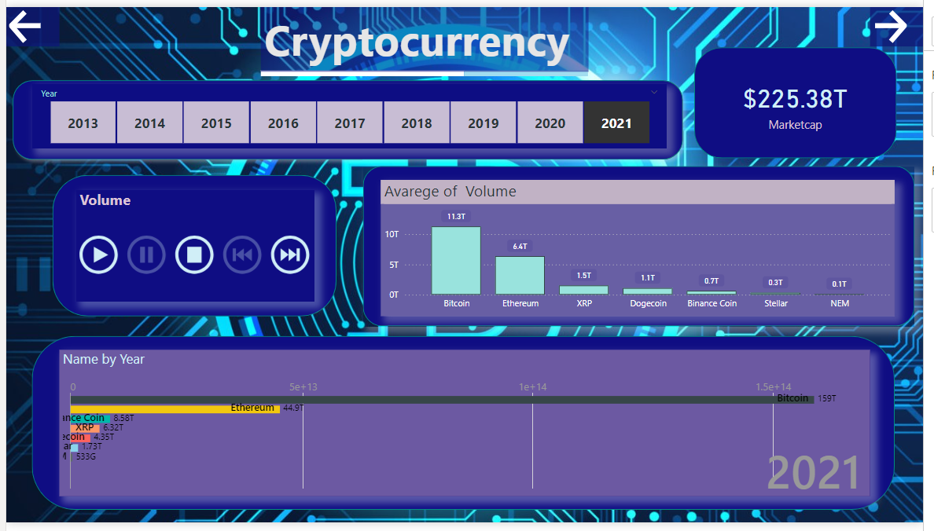
Power BI Report - Page1

Slide 13
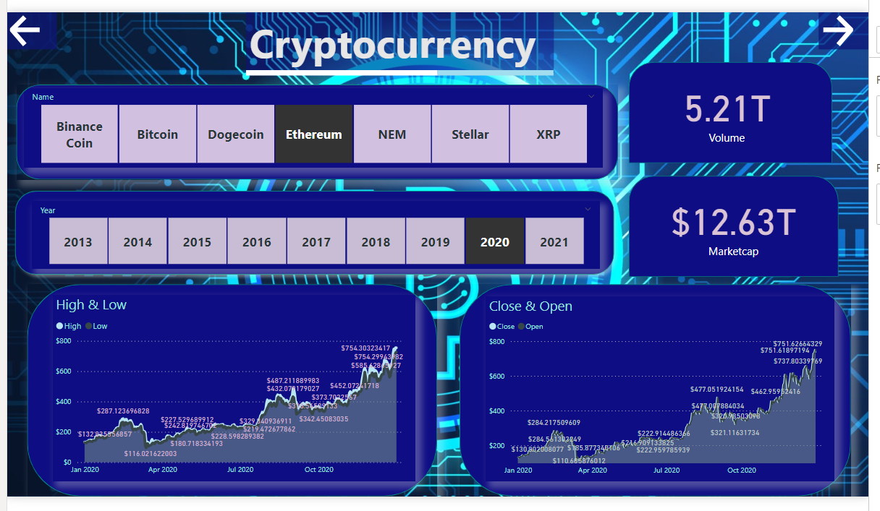
Power BI Report - Page2

Slide 14
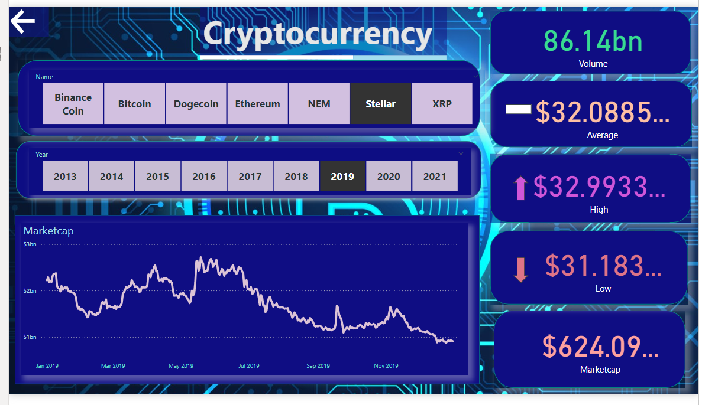
Power BI Report - Page3

Slide 15
THANK YOU
.

